Slide 1

CSE 473
Pattern Recognition

Slide 2
Bayesian Classifier and its Variants

Slide 3
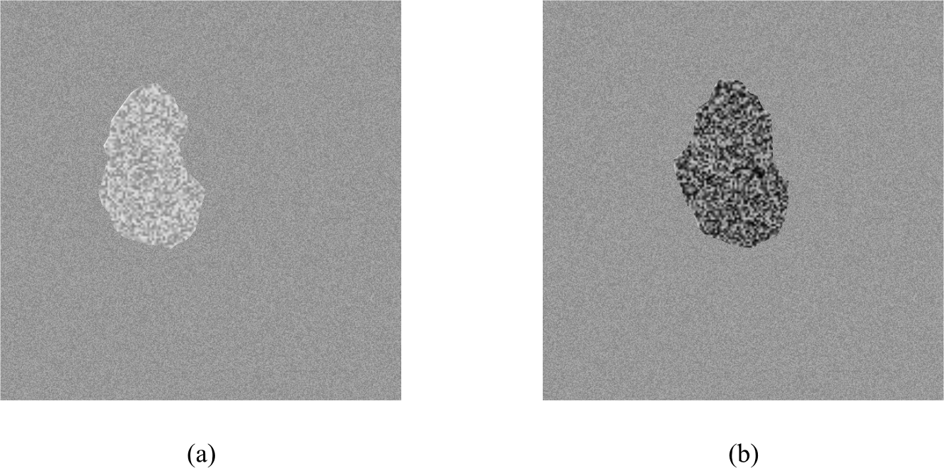
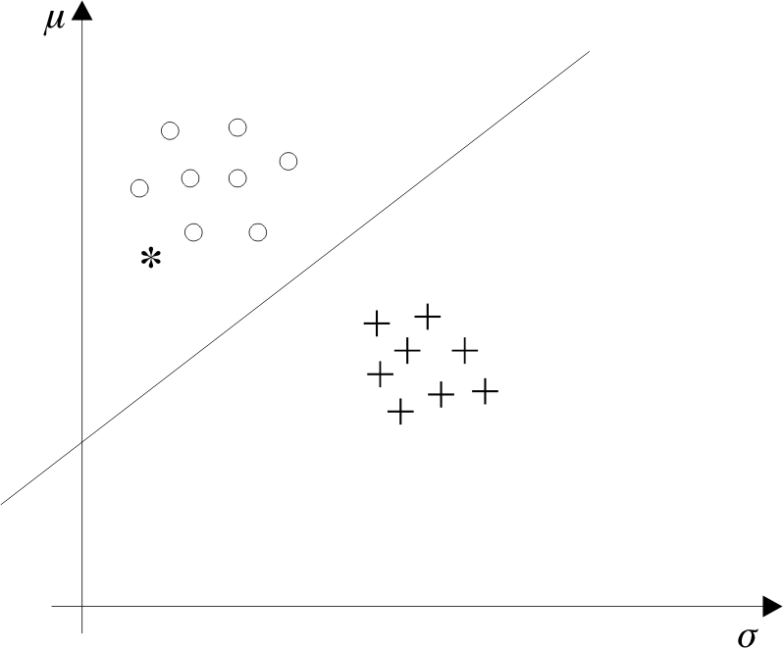
Recall from Lecture 1

Slide 4
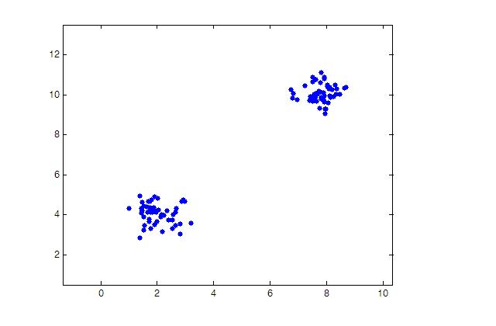
Sample Data for Sessional on
Bayesian Classification

Slide 5
Feature 1 | Feature 2 | Class
1.7044 | 3.6651 | 1
1.6726 | 4.6705 | 1
1.4597 | 4.194 | 1
1.9761 | 4.1965 | 1
1.9126 | 3.4987 | 1
1.5214 | 3.9072 | 1
2.6463 | 3.473 | 1
2.2205 | 3.9642 | 1
6.8104 | 10.0517 | 2
7.5809 | 9.8897 | 2
8.1287 | 9.8605 | 2
7.9081 | 9.6332 | 2
7.9162 | 9.9677 | 2
7.9415 | 9.278 | 2
8.0842 | 10.3062 | 2
7.7494 | 9.3382 | 2
8.1146 | 9.9617 | 2
Sample Data
for
Bayesian
Classification

Slide 6
Naïve Bayes (Summary)
Simplify the probability expression
Robust to
  isolated noise points
  missing values
  irrelevant attributes

Slide 7
Naïve Bayes (Issues)
Over simplification
  Use other techniques such as Bayesian Belief Networks (BBN)

Slide 8
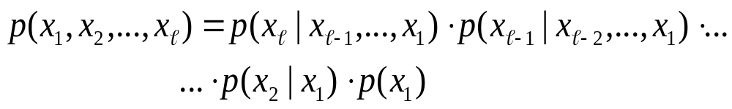
Bayesian Belief Networks
Let we have l random variables
The joint probability is given by,

Slide 9
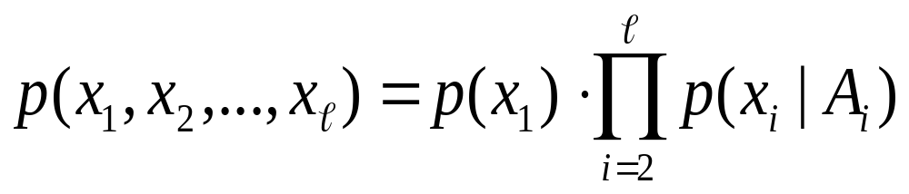
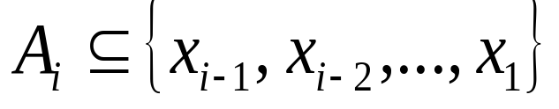
Bayesian Belief Networks
  The formula
  can be written as
  where

Slide 10
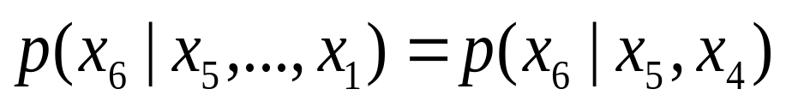
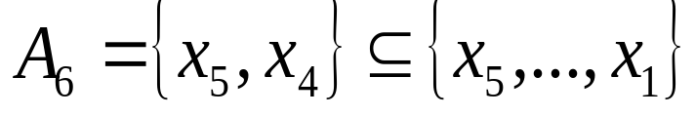
  For example, if ℓ=6, then we could assume:
  Then:

Slide 11
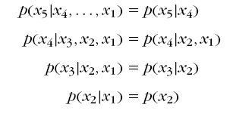

  Simialrly, if we assume
  Then:

Slide 12
  Simialrly, if we assume
  Then:
  The above is a generalization of the Naïve – Bayes. For the Naïve – Bayes the assumption is:
  A_{i} = Ø, for i=1, 2, …, ℓ

Slide 13
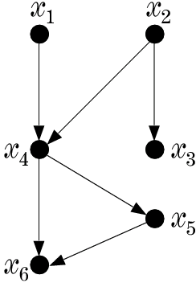
  A graphical way to portray conditional dependencies

Slide 14
  A graphical way to portray conditional dependencies
  According to this figure, we have :
    x₆ is conditionally dependent on x₄, x₅.
    x₅ on x₄
    x₄ on x₁, x₂
    x₃ on x₂
    x₁, x₂ are conditionally independent on other variables.

Slide 15
  A graphical way to portray conditional dependencies
  According to this figure, we have :
    x₆ is conditionally dependent on x₄, x₅.
    x₅ on x₄
    x₄ on x₁, x₂
    x₃ on x₂
    x₁, x₂ are conditionally independent on other variables.
  For this case:

Slide 16
Bayesian Networks
  a directed acyclic graph (DAG)
  the nodes correspond to random variables
  arc represents parent-child (dependence) relationship

Slide 17
A Bayesian Network is specified by:
  The prior probabilities of its root nodes.
  The conditional probabilities of the non-root nodes, given their parents, for ALL possible combinations.

Slide 18
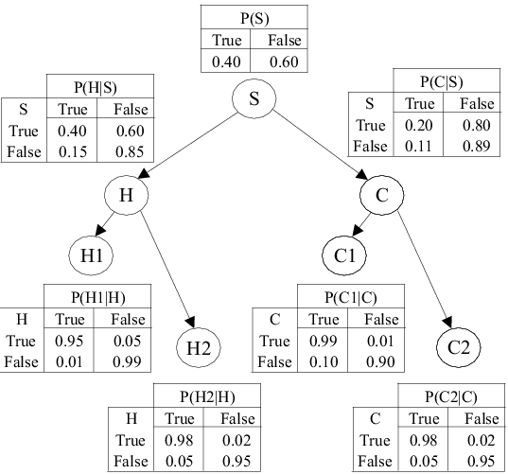
  A Bayesian Network from a medical application
  This BBN models conditional dependencies concerning smokers’ (S), tendencies to develop cancer (C) and heart disease (H), together with variables corresponding to heart (H1, H2) and cancer (C1, C2) medical tests.

Slide 19
  Training: given a topology, probabilities are estimated from training data. There are also methods that learn the topology.
  any joint probability can be obtained by multiplying the prior (root nodes) and the conditional (non-root nodes) probabilities.
  Probability Inference: Given a pattern (evidence), the goal is to compute the conditional probabilities for some of the other variables (class)

Slide 20
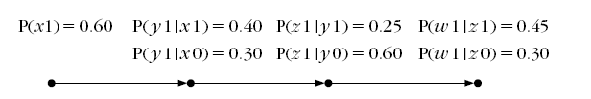
Example: Consider the Bayesian network of the figure:
Random variables: x, y, z, w
x0 means x = 0
x1 means x = 1
x
y
z
w

Slide 21
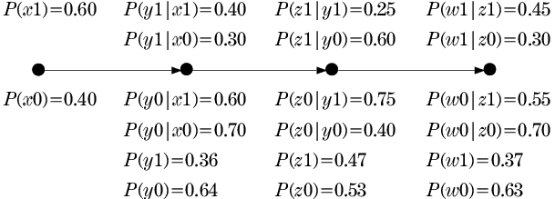
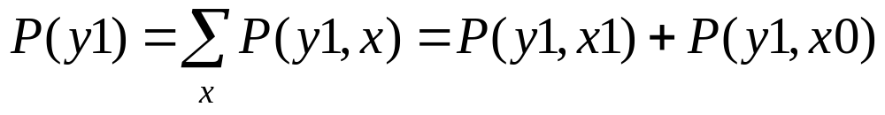
We can calculate the other probabilities
Example: p(y₁):
x
y
z
w

Slide 22
We can calculate the other probabilities
x
y
z
w

Slide 23
Given this info, we can answer any probabilistic query:
a) If x is measured to be x=1 (x1), compute P(z1|x1) and P(w0|x1).
b) If w is measured to be w=1 (w1) compute P(z1|w1)].
x
y
z
w

Slide 24
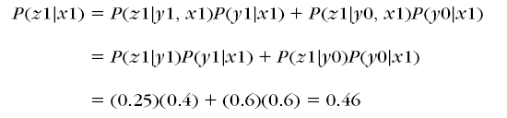
a) If x is measured to be x=1 (x1), compute P(z1|x1) and P(w0|x1).
x
y
z
w

Slide 25
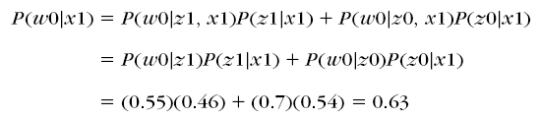
a) If x is measured to be x=1 (x1), compute P(z1|x1) and P(w0|x1).
x
y
z
w

Slide 26

b) If w is measured to be w=1 (w1) compute P(z1|w1|)].
x
y
z
w

Slide 27
c) CAN WE CALCULATE P(x0|w1|)]?
x
y
z
w

Slide 28
What’s about more complex networks?

Slide 29
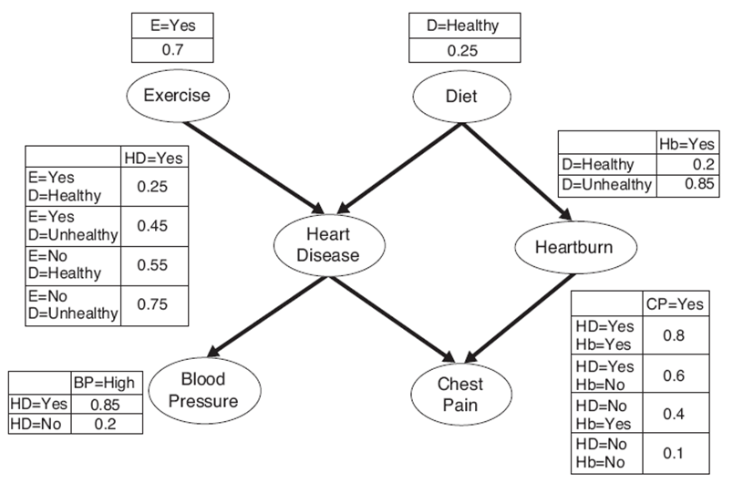
What’s about more complex networks?

Slide 30
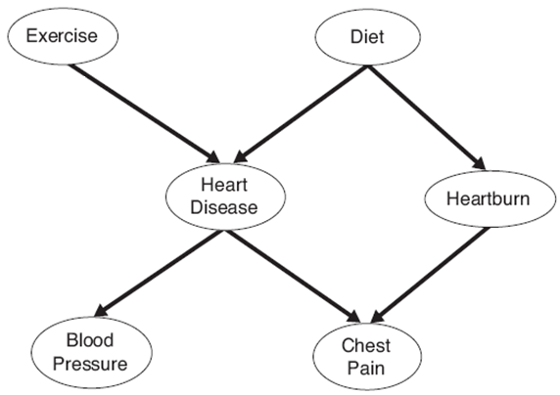
We will study this graph
We can show:
P(D|E)=P(D)
P (Hb|HD, E, D)= P (Hb|D)
P (CP|Hb, HD, E, D)= P (CP|Hb, HD)
P (BP|CP, Hb, HD, E, D)= P (BP|HD)
However, P (HD|E,D) cannot be simplified

Slide 31
We will study this graph
Non-descendant conditions can be removed provided all parents are given
We can show:
P(D|E)=P(D)
P (Hb|HD, E, D,CP)= P (Hb|D, CP)
P (CP|Hb, HD, E, D)= P (CP|Hb, HD)
P (BP|CP, Hb, HD, E, D)= P (BP|HD)
However, P (HD|E,D) cannot be simplified

Slide 32
Exercise:
P (CP|HD, BP, E, D)= ?

Slide 33
Exercise:
P (CP|HD, BP, E, D)= No simplification

Slide 34
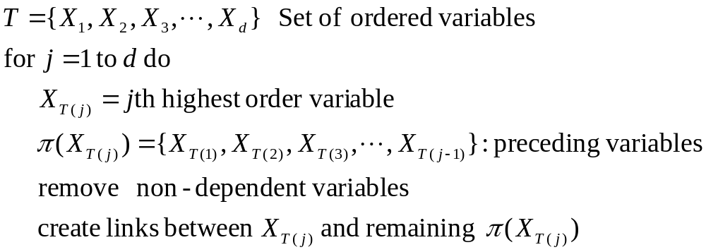
BBN Model Building

Slide 35
We will study this graph
Order: E, D, HD, Hb, CP, BP

Slide 36
We will study this graph
Order: E, D, HD, Hb, CP, BP

Slide 37
Calculate P(HD=yes) ?

Slide 38
Calculate P(HD=yes) ?
where,
α = Set of Values of Exercise(E) = {Yes, No}
β = Set of Values of Diet(D) = {Healthy, Not Healthy}

Slide 39
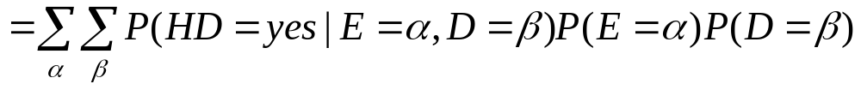
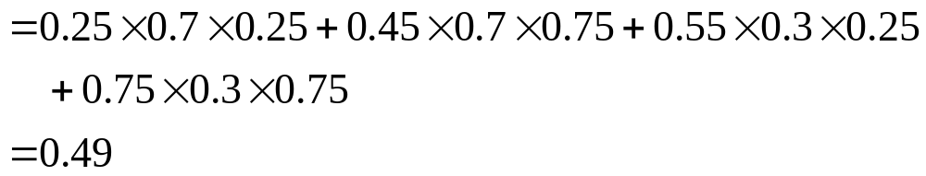
Calculate P(HD=yes) ?

Slide 40
Calculate: P(HD=yes|BP=High)?

Slide 41
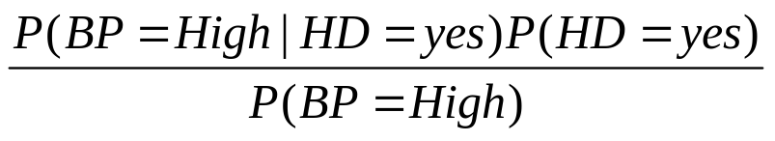

Calculate P(HD=yes|BP=High)
can be written as

Slide 42
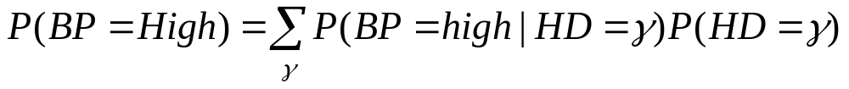
Calculate P(HD=yes|BP=High)
where,
γ = Set of Values of Heart Disease (HD) = {Yes, No}

Slide 43
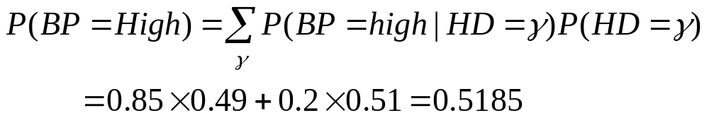
Calculate P(HD=yes|BP=High)

Slide 44
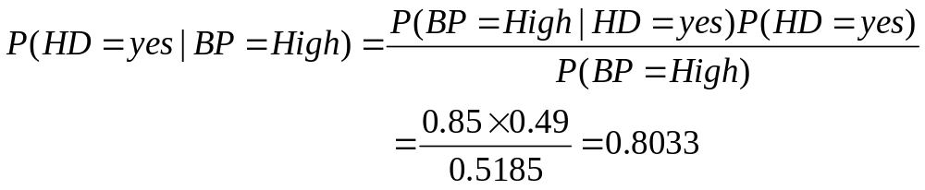
Calculate P(HD=yes|BP=High)

Slide 45
Calculate P(HD=yes|BP=high, D=Healthy, E=yes)?

Slide 46
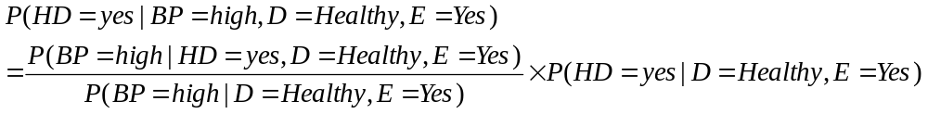
Calculate P(HD=yes|BP=high, D=Healthy, E=yes) ?

Slide 47
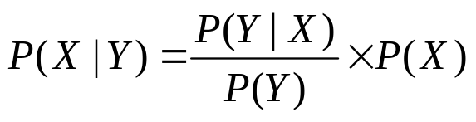
How is this formula true?
Let

Slide 48
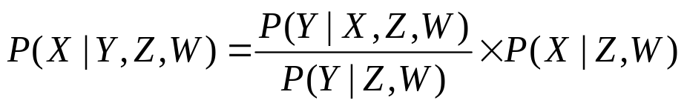
How is this formula true?
Let
Now add Z and W as condition

Slide 49
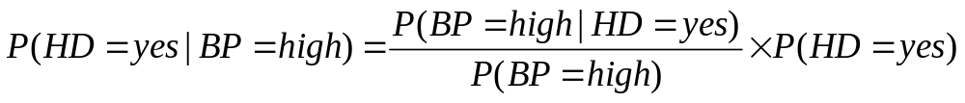
How is this formula true?
Let
Now add Z and W as condition
Similarly,

Slide 50
How is this formula true?
Let
Now add Z and W as condition
Similarly,
Now add conditions D= Healthy and E= Yes to above formula

Slide 51
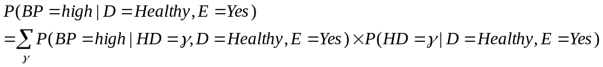
Similarly,

Slide 52
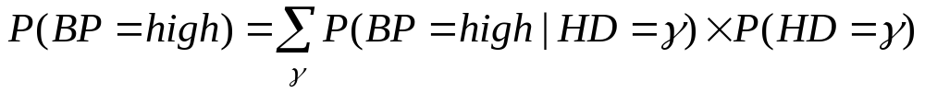
Similarly,
Proof:

Slide 53
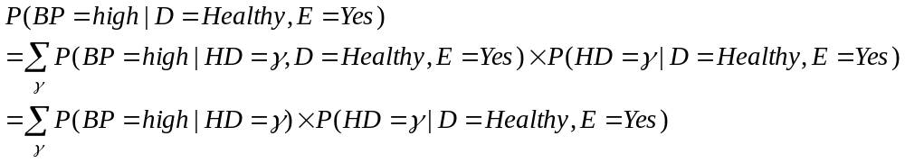
Similarly,
Proof:
Adding conditions D= Healthy and E= Yes
we get,

Slide 54
Similarly,
Proof:
Adding conditions D= Healthy and E= Yes
we get,

Slide 55
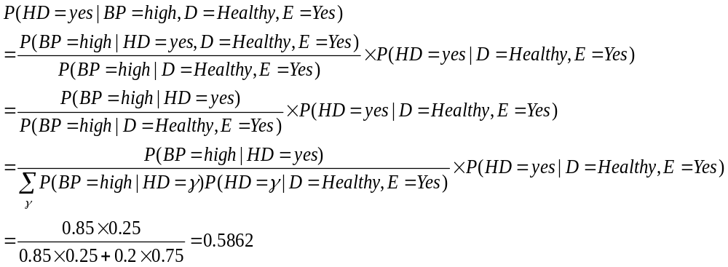

Slide 59
Review of Bayesian Classifier and its variants
underlying probability densities were known
training sample are used to estimate the probabilities

Slide 60
Linear Classifier: Introduction
Classifies linearly separable patterns
Assume proper forms for the discriminant functions
may not be optimal
very simple to use

Slide 61
Linear discriminant functions and decisions surfaces
Definition
  Let a pattern vector x = {x₁, x₂, x₃, …,}
  a weight vector w = {w₁, w₂, w₃, …,}
  A discriminant function :
  g(x)=x₁w₁+x₂w₂+x₃w₃+…
  OR
  g(x) = w^{t}x + w₀ (1)
  where w is the weight vector and w₀ the bias

Slide 62
Linear discriminant functions and decisions surfaces
Classify a new pattern x as follows
Decide class ω₁ if g(x) > 0
and class ω₂ if g(x) < 0
If g(x) = 0 ⇒ x is assigned to either class

Slide 63
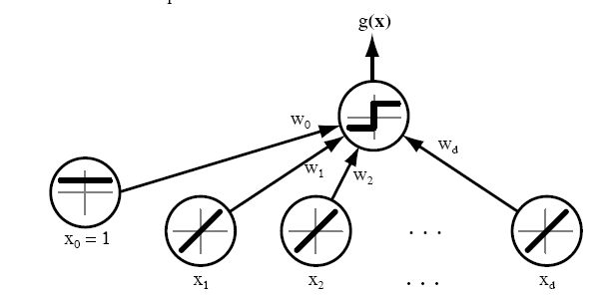
Linear discriminant functions and decisions surfaces

Slide 64
  The equation g(x) = 0 is the decision surface that separates patterns
  When g(x) is linear, the decision surface is a hyperplane

Slide 65
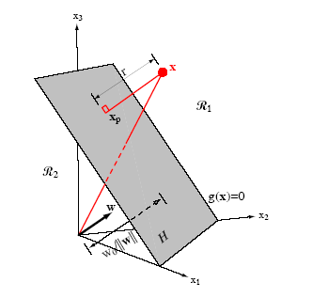

Slide 66
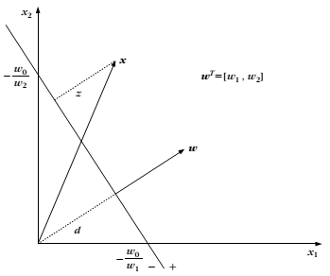

Slide 67
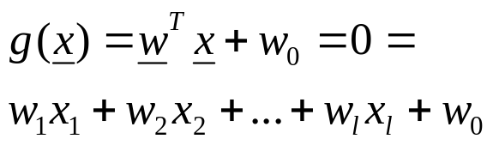
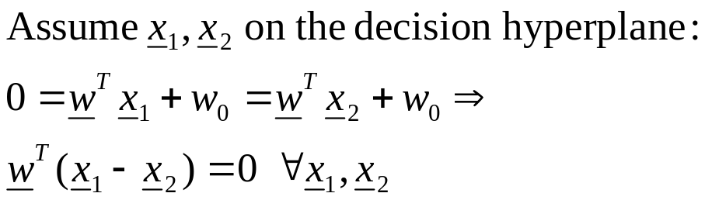
A little bit mathematics
The Problem: Consider a two class task with ω₁, ω₂

Slide 68

  Hence:

Slide 69
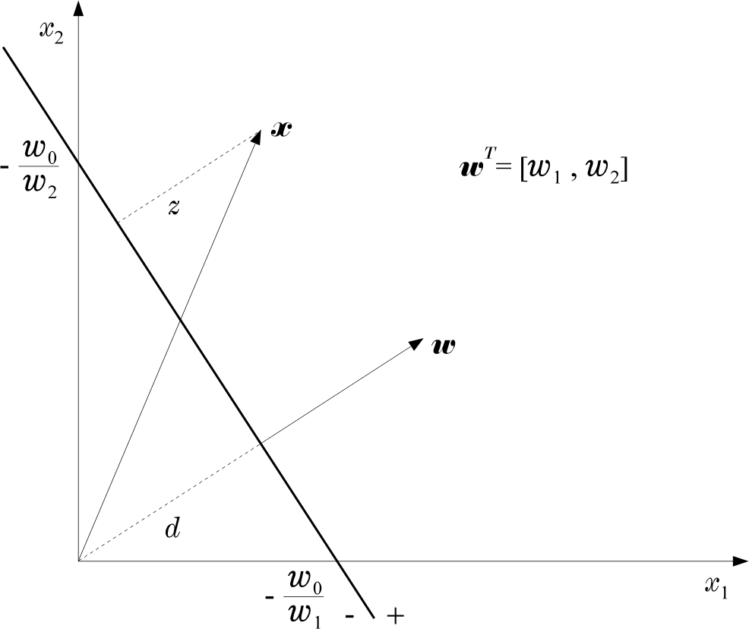
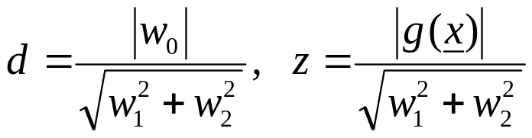
  Hence:

Slide 70
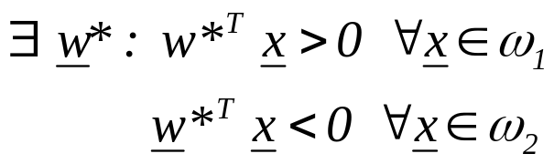
The Perceptron Algorithm
  Assume linearly separable classes, i.e.,

Slide 71
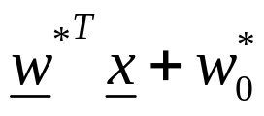
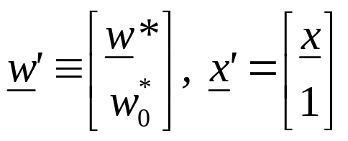
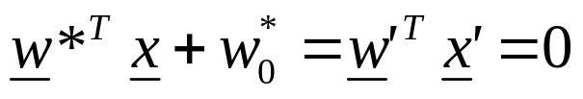
The Perceptron Algorithm
  Assume linearly separable classes, i.e.,
  The case
  falls under the above formulation, since

Slide 72
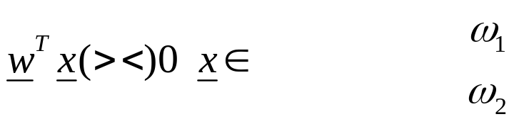
  Our goal: Compute a solution, i.e., a hyperplane w,
  so that
    The steps
      Define a cost function to be minimized
      Choose an algorithm to minimize the cost function
      The minimum corresponds to a solution

Slide 73
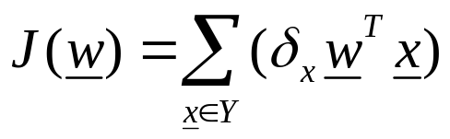
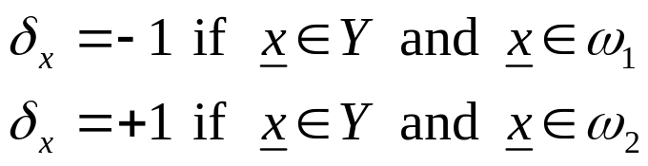
  The Cost Function
    Where Y is the subset of the vectors wrongly classified by w.

Slide 74
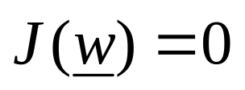
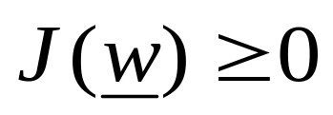
  The Cost Function
    Where Y is the subset of the vectors wrongly classified by w.
    when Y=(empty set) a solution is achieved and
    otherwise

Slide 75

    J(w) is piecewise linear (WHY?)
  The Algorithm
    The philosophy of the gradient descent is adopted.

Slide 76
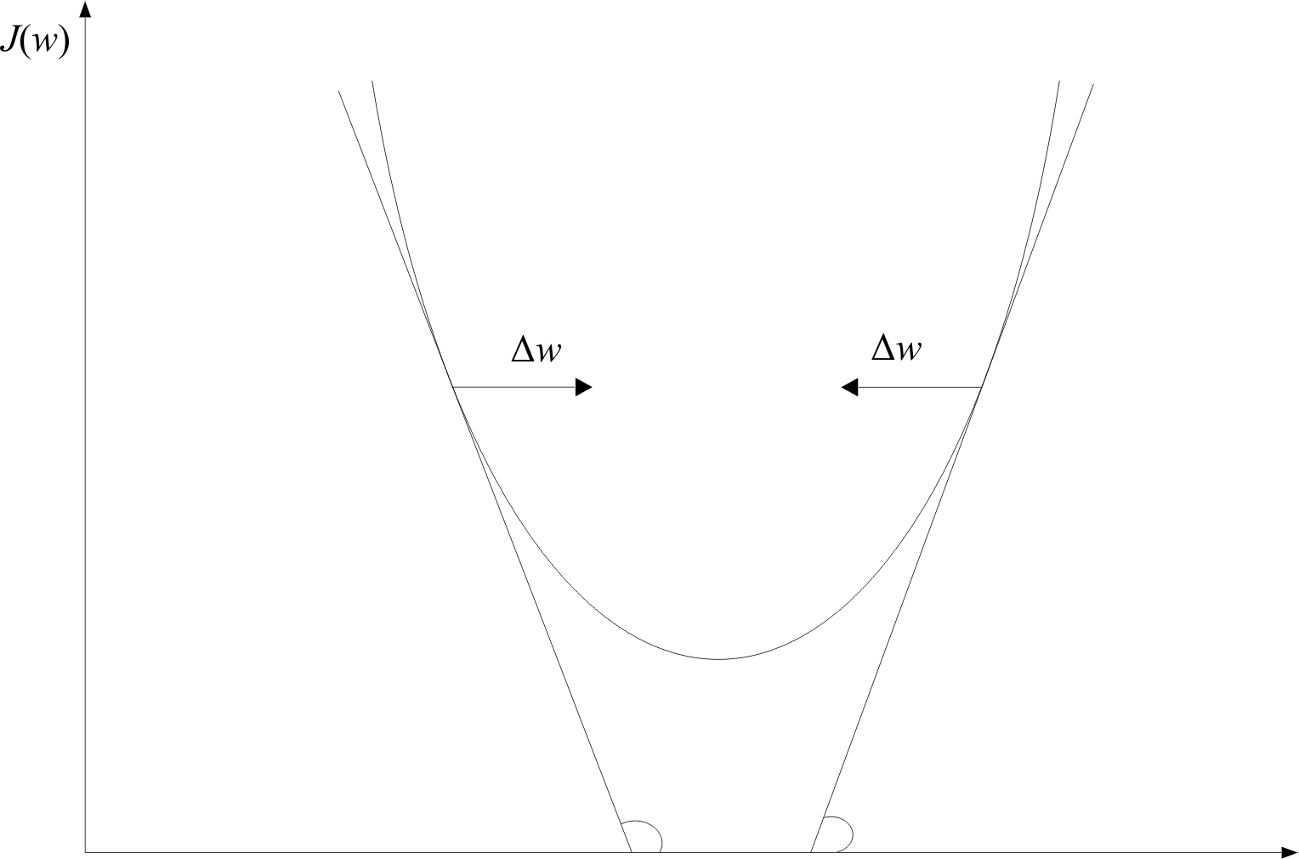

w

Slide 77


    Wherever valid
    This is the celebrated Perceptron Algorithm
w

Slide 78


  An example:

Slide 79
  An example:
  The perceptron algorithm converges in a finite number of iteration steps to a solution if patterns are linearly separable

Slide 80


  Example: At some stage t the perceptron algorithm results in

Slide 81

  Example: At some stage t the perceptron algorithm results in
  The corresponding hyperplane is
+
+
+
+
ρ=0.7
+
+
+

Slide 82

  Example: At some stage t the perceptron algorithm results in
  The corresponding hyperplane is
+
+
+
+
ρ=0.7
+
+
+

Slide 83
  Example: At some stage t the perceptron algorithm results in
  The corresponding hyperplane is
+
+
+
+
ρ=0.7
+
+
+

